Slide 1
Cultural Competency & Linguistic Services Training
1

Slide 2
Training Goals
1. Understanding the requirements
2.
Tips on working with patients with Limited English Proficiency (LEP)
3.
Define culture, cultural competence, and cultural humility
4.
Learn cross-cultural communication strategies
5.
Learn strategies for addressing the needs of LGBTQ+ (lesbian, gay, bisexual, and transgender, queer +) patients
6.
Learn strategies for working with seniors and persons with disabilities
2

Slide 3
Linguistic Services Terms
Limited English Proficient (LEP)-when an individual cannot speak, read, write, or understand the English language at a level that permits them to interact effectively with clinical or non-clinical staff in a health care setting.
Language Access Services- the collective name for any service that helps an LEP patient obtain the same access to and understanding of health care as an English speaker would have. This can include the use of bilingual staff and interpreters. It also includes the provision of translated documents.
Interpretation-the process of understanding and analyzing a spoken or signed message and re-expressing that message faithfully, accurately, and objectively in another language, taking the cultural and social context into account.
Translation- the conversion of a written text into a corresponding
written text in a different language.
3

Slide 4
Requirement to Use Interpreters for LEP Patients
State
DMHC, SB853
DHCS (Medi-Cal)
Healthy Families, AIM
Federal
Title VI of the Civil Rights Act of 1964
EMTALA
Hill-Burton Act
Executive Order 13166
CMS
Others
JCAHO
4

Slide 5
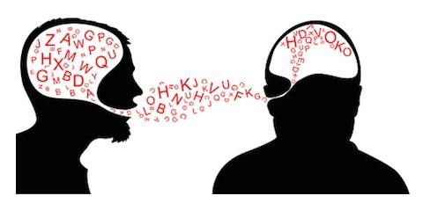
Why is Linguistic Access Important?
Accurate communication between patient and health care provider is essential for proper diagnosis, treatment, and patient compliance. Being able to communicate clearly with patients also:
Reduce health disparities
Improve patient adherence to treatment plan
Improve quality of care
Improve patient interactions, experience, and satisfaction
Plays an important part of complying with federal and state requirements
5

Slide 6
Linguistic Access Reduces Health Disparities
Patients with language barriers may experience:
Poorer patient assessment
Misdiagnosis and/or delayed treatment
Incomplete understanding of patient condition and prescribed treatment
Impaired confidence in services received
Reliance on Google Translate and ad hoc, untrained interpreters (in spite of evidence highlighting the risks associated with such practice)
Source: de Moissac, D., & Bowen, S. (2019). Impact of Language Barriers on Quality of Care and Patient Safety for Official Language Minority Francophones in Canada.
Journal of Patient Experience, 6(1), 24–32.
6

Slide 7
For Your Reference
Regulations mandating use of interpreter services and bilingual staff for Limited English Proficiency (LEP) patients:
Federal
42 U.S.C. §§2000d- United States Code Title 42, The Public Health and Welfare Chapter 21, Civil Rights Subchapter V. Federally Assisted Programs, Prohibition against exclusion from participation in, denial of benefits of, and discrimination under federally assisted programs on ground of race, color, or national origin
State
DHCS/SFHP Contract Exhibit A, Attachment 9, Provision 14- Access and Availability, Linguistic Services
DHCS All Plan Letter 14-008- Standards for Determining Threshold
Languages
DHCS All Plan Letter 99-03- Year 2000 Readiness Certification and Business Continuation Plan
DHCS All Plan Letter 99-04- New Laws from the 1997-98 Session of the California Legislature Affecting the Medi-Cal Program
22 CCR §53853(c-d)- California Code of Regulations, Title 22. Social Security, Division 3. Health Care Services, Subdivision 1., California
Medical Assistance Program, Chapter 4.1. Two-Plan Model Managed Care Program, Article 6. Operational Requirements, § 53853 Accessibility of Services
28 CCR §1300.68(b)(3), California Code of Regulations, Title 28. Managed Health Care, Division 1. , The Department of Managed Health Care, Chapter 2. Health Care Service Plans, Article 8. Self-Policing Procedures, §1300.68 Grievances and Appeals
HSC § 1367.04- Health and Safety Code, § 1367.04 Knox Keene Act
7

Slide 8
Medi-Cal Requirements
Interpreter services must be available 24/7 at no charge
to patients
Required to document in patients’ medical record:
Patient's preferred language
Patient's refusal of interpreter services (if applicable)
Providers should discourage the use of friends, family patients, or minors as interpreters (unless specifically requested by the patient)
Patients have the right to file grievances or complaints
if linguistic needs are not met
Interpreters and bilingual staff should be assessed for language capacity (qualified)
Providers and office staff must be knowledgeable about
linguistic access and cultural awareness
8

Slide 9
What Do Providers Need to Do?
To provide appropriate linguistic access to patients, you first have to:
Be familiar with available interpreter services
The following should be documented in each patients’ medical record
Patient’s preferred language
Patient’s refusal of interpreter services
Discourage the use of friends, family members, or minors as interpreters (unless specifically requested by the member)
Ensure all providers and staff are trained for linguistic access and cultural awareness
9

Slide 10
Asking Patients About Language Preference
How you ask a patient about his or her language will affect the response you get:
“You won’t need an interpreter, will you?”
Asking the question this way discourages the patient, or the person who is making the appointment, from asking for the language assistance that he or she may need.
“What language do you speak at home?”
This question will get you information about the patient’s home language, but ignores the possibility that the patient may be bilingual in English as well.
“Will an interpreter be needed? In what language?”
Patients may say no because they believe they have to either bring their own interpreter or have a family member interpret.
“In what language do you prefer to receive your health care?”
Asking the question this way will provide you information on the language the patient feels he
or she needs to speak in a health-related conversation.
If the answer is a language other than English, you can plan to have language assistance available for the patient, and you should add this information to the record.
10

Slide 11
Avoid Family, Friends or Minors as Interpreters
Family or friends of patients may withhold information from the patient because of embarrassment, protection, or emotional involvement
Family or friends of patients may have their own agenda
Family or friends of patients may not be familiar with medical vocabulary
Using a patient’s child as an interpreter may make the parent feel disempowerment and burden the child (role reversal)
11

Slide 12
Documenting Patient Language Preference
It is important to record language preference and interpreter needs in patients’ medical
record. You may use the following techniques:
Minimum: Add a color or letter code to the patient’s chart, noting that the patient needs an interpreter. Designate a code or color for each language.
Better: Add the information under “Notes” in a patient’s entry in your
patient database, so that when a receptionist pulls up the patient’s record to make an appointment, the information about the need for an interpreter and the language can be noted as well.
Best: Add a question on your patient registration form or in your practice management system. Not only will you know when a patient is scheduled that he or she will need an interpreter, you will also be able to track how many patients you have who speak a particular language and how often they are seen.
12

Slide 13
How Can You Be Culturally Competent in HealthCare?
▶ Recognize that people of different cultures have different ways of communicating, behaving, interpreting, and problem-solving.
▶ Recognize that cultural beliefs impact patient’s health beliefs, help-seeking activities, interactions with health care professionals, health care practices, and health care outcomes, including adherence to prescribed regimens.
13

Slide 14
Working with Interpreters: On-site
Greet the patient first, not the interpreter.
Face and talk to the patient directly.
Speak at an even pace in relatively short sentences.
Speak in standard English and avoid medical terminology and jargon.
Ask one question at a time.
Avoid interrupting the interpretation.
Don’t make assumptions about the patient's education level, an inability to speak English does not necessarily indicate a lack of education.
14

Slide 15
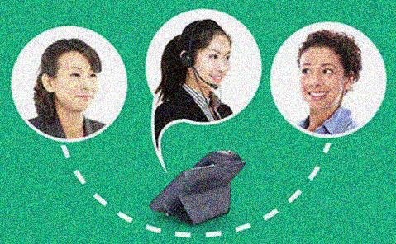
Working with Interpreters: By Phone
When working with an interpreter over the phone, many of the principles of on-site interpreting apply, the only additional thing to remember is that the interpreter is “blind” to the visual cues in the room.
When the interpreter comes onto the line, let the interpreter know who you are and what type of call it is.
For example, “Hello interpreter, this is James. I have Mrs. Dominguez on the phone who wishes to schedule an appointment as a new patient.”
Give the interpreter the opportunity to quickly introduce themselves to the patient.
15

Slide 16
What is Culture?
Culture is an umbrella term which encompasses the social behavior and traditions found in societies, as well as the knowledge, beliefs, arts, laws, customs, capabilities and habits of the individuals in these groups.
16

Slide 17
Terminology
Cultural awareness is being cognizant, observant, and conscious of similarities and differences among and between cultural groups.
Cultural and linguistic competence is a set of congruent behaviors, attitudes, and policies that come together in a system, agency, or among professionals that enables effective work in cross-cultural situations.
Cultural humility is a commitment and active engagement in a lifelong process that individuals enter into on an ongoing basis with patients, communities, colleagues, and with themselves.
17

Slide 18
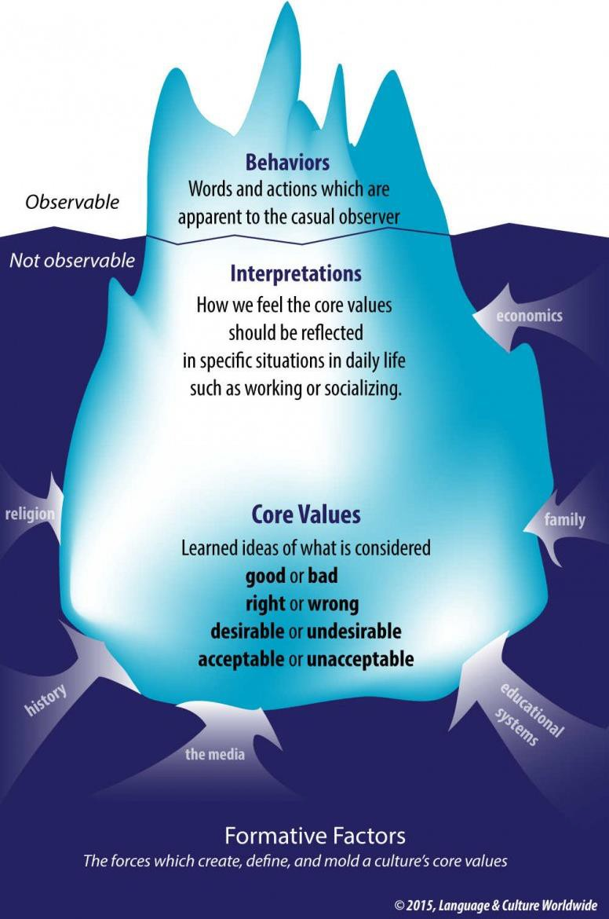
Cultural Influences Can Be Seen or Unseen
18

Slide 19
What is Cultural Competence in Health Care?
Cultural competency in health care describes the ability of systems to provide care to patients with diverse values, beliefs and behaviors, including the tailoring of health care delivery to meet patients' social, cultural and linguistic needs.
A culturally competent health care system is one that acknowledges the importance of culture, incorporates the assessment of cross-cultural relations, recognizes the potential impact of cultural differences, expands cultural knowledge, and adapts services to meet culturally unique needs.
In health care systems and public health research cultural competency is recognized as an essential means of reducing racial and ethnic disparities in health care.
19
Source: American Hospital Association

Slide 20
Tips for Cross Cultural Communication
Respect
Diversity
Communicate
Clearly
Understand
Differences
Engage the
Individual
Recognizing what you have in common
Speak simply and enunciate. Address limited literacy skills.
Understanding customs and values that can lead to tension
Working with people with different cultural perspectives
Be inclusive of different customs, values, perspectives
Use interpreter services when needed
Knowing yourself and your own cultural perspectives
Negotiating differences across cultures
Avoiding stereotypes and assumptions
Ask questions to confirm information was understood.
Learning about others and their cultural perspectives
20

Slide 21
Caring for LGBTQ+ Communities
LGBTQ+- people who may identify as lesbian, gay, bisexual, transgender, queer, or may not identify as heterosexual. The “+” is a denotation of everything on the gender and sexuality spectrum that words may not yet describe.
Patients have diverse sexual orientations
Identify your own LGBTQ+ perceptions and biases as a first step in providing the best quality care.
Many LGBTQ+ people do not disclose their sexual orientation or gender identity because they don’t feel comfortable, or they fear receiving substandard care.
Patients have diverse gender identities, which may include but are not limited to:
Cisgender- A person whose gender identity matches the sex they were
assigned at birth.
Transgender- A wide-ranging term for people whose gender identity or gender expression differs from the biological sex they were assigned at birth (it is important to note that people may or may not choose to alter their bodies hormonally and/or surgically).
Non-binary- A person who identifies as neither male nor female and sees themselves outside the gender binary.
Source: Fenway Health, New York Times
21

Slide 22
Tips for Working with Transgender patients
Treat transgender people as you would want to be treated.
Always refer to transgender people by their name when possible.
Don’t assume someone’s gender identity, ask:
“Which pronouns do you use?”
“Do you have a chosen name I should use?”
Focus on excellent customer services rather than indulging in
questions out of curiosity.
Do not ask about a transgender person’s genital status if it is unrelated to providing them with excellent customer service.
Never disclose a person’s transgender identity to anyone who does not explicitly need this information to provide excellent care or service to the patient.
Source: Transgender Law Center
22

Slide 23
Caring for Seniors and Persons with Disabilities (SPDs)
Accommodating the needs of SPDs ensures the following:
Appropriate and effective care
Compliance with the Federal Americans with Disabilities Act (ADA) and Section 504 of the 1973 Rehabilitation Act
The ADA and Section 504 require that healthcare services provide certain accommodations that ensure equitable and non- discriminatory access to care
SFHP’s Seniors and Persons with Disabilities (SPDs)
70% with 2+ chronic conditions
25% have 4+ chronic conditions
30% receive treatment for mental health conditions
23

Slide 24
Dimensions of Disability
Disease/ Multiple Medications
Visual
Impairment
Hearing
Impairment
Seniors/Persons with Disabilities
Caregiver Burden
Physical Impairment
Cognitive Impairment/ Mental Health
24
Source: US Dept of Health and Human Services, 2007

Slide 25
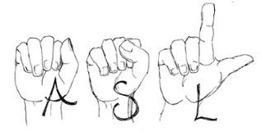
Making Accommodations for Seniors and Persons with Disabilities (SPDs)
What patients may need:
Physical accessibility
Effective communication
Sign language interpreters, assistive listening devices, print materials in accessible formats
Policy modification (for example, to allow more time for an office visit)
Accessible medical equipment
25

Slide 26
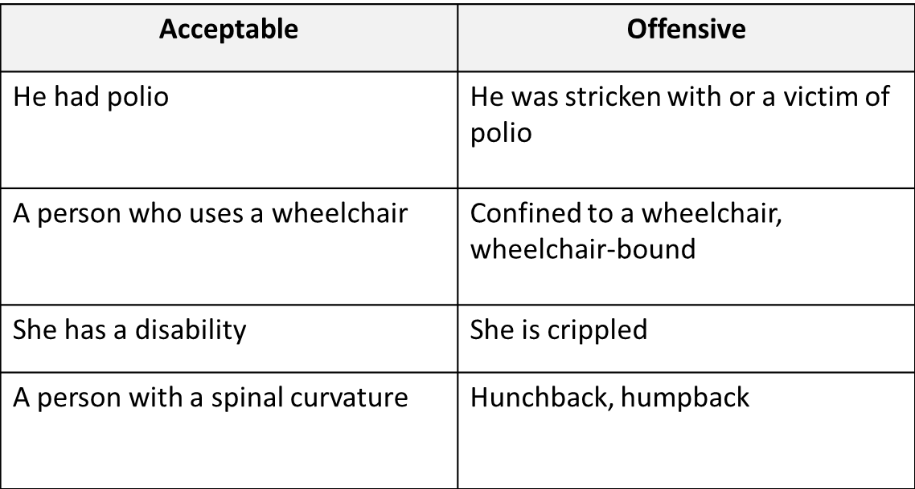
Examples of Preferred Terms To Use

Slide 27
When Interacting with Seniors:
Avoid age stereotyping when providing information and recommendations about care
Offer information in a clear, direct, and simple manner
Don’t assume limitations exist just based on age
Recognize the senior as the expert in their own life
Quote from a senior activist: “As Seniors we know our capabilities and energy are diminishing, but want to retain the right to limit ourselves when the time comes, and not have young people put those limitations on us, to make them feel better.”

Slide 28
Interacting with People with Physical Disabilities
Mobility and physical disabilities range from people who have mild to those with significant limitations.
If shaking hands is appropriate, do so. People with limited hand use or who use a prosthesis can usually shake hands. If people have no arms, lightly touch their shoulder.
When speaking to a person using a wheelchair or scooter for more than a few minutes, try to find a seat or kneel so that you are at the same eye level.
Always ask for permission before moving someone’s cane, crutches, walker, or wheelchair.

Slide 29
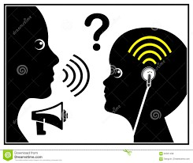
Interacting with People with Speech Disabilities
Some (not all) people with limited speech have difficulty understanding what people say to them because of their disability, age, hearing loss, cognitive difficulties and/or language differences.
Repeat what the person tells you to confirm that you understood.
Do not raise your voice. People with speech disabilities can hear you.
Ask questions one at a time. Give individuals extra time to respond.
Pay attention to pointing, gestures, nods, sounds, eye gaze, and blinks.
If you have trouble understanding a person’s speech, it’s ok to ask them to repeat what they are saying, even three or four times. It is better for them to know that you do not understand, than to make an error.

Slide 30
Interacting with Visually Impaired Patients
People can have a range of visual disabilities, from having no vision to people who have low vision and may be able to read large print.
When offering help, identify yourself and let people know you are speaking to them by gently touching their arm. If you leave people’s immediate area, tell them so they will not be talking to empty space.
Speak directly facing the person. Your natural speaking tone is sufficient.
When giving directions, be specific. Clock clues may be helpful, such as “the desk is at 6 o'clock.” When guiding a person through a doorway, let them know if the door opens in or out and to the right or to the left.
People who are blind or have visual impairments may request print materials in accessible formats such as digital, audio, large print, or Braille.

Slide 31
Interacting with Hearing Impaired Patients
Even when a patient with a hearing impairment utilizes hearing aids and active listening strategies, it is critical that all people involved in a conversation put in their best effort for successful communication.
Helpful tips to remember:
Speak normally, not too fast or too slowly. Use short, simple sentences.
Do not exaggerate your speech or lip movements.
If the patient can sign, use an interpreter.
Be prepared to write down any questions or answers, and give the person with a hearing impairment the opportunity to do the same if necessary.
Write down important information, e.g. health education or instructions, to give to the patient.
Make sure the room has enough lighting. People with hearing loss often rely upon lip reading, facial expressions, body language and gestures to improve communication.
Minimize background noise.
Make it easy to see everyone's faces. If you will be in a group setting, choose a location where the person with hearing loss will have visual access to everyone's faces.
People tend to agree with their health care workers, sometimes without understanding what has been said to them. After every important point or message, ask the patient if they understood you and, if necessary, ask them to repeat the message or instructions back to you (especially important if the patient is unaccompanied).
31

Slide 32
Interacting with Patients with Cognitive Impairments or Mental Health Challenges
A cognitive or psychiatric disability can affect a patient’s understanding, memory, language, judgment, and learning. These disabilities include patients with intellectual disabilities, head injury, strokes, autism, Alzheimer's disease, and emotional disabilities.
Offer information in a clear, concise, concrete, and simple manner.
If you are not being understood, modify your method of communicating. Use common words and simple sentences.
Allow time for people to process your words, respond slowly, or in
their own way.
Make sure the person understands your message.
32

Slide 33
Questions?
Contact compliance@aamgdoctors.com
33

